Slide 1
ADAPTIVE LEARNING PATH
K.Sai krishna
G-431
030-cse-a

Slide 2
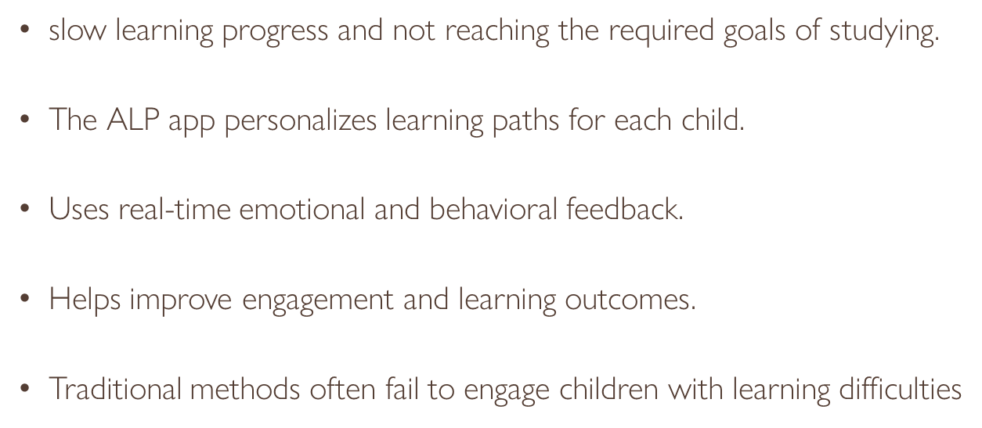
Project application and application effectiveness :
Personalized learning for children with learning difficulties.
Analyzes emotions and behavior in real-time.
Adapts learning path to boost engagement.
Follows therapist guidelines for effective support.

Slide 3
User and User benefits
Typical users: Children with learning difficulties, therapists, and educators
Parents and caregivers use the app to track progress and support learning
Designed to enhance the educational experience for both children and
professionals involved in their development
The Adaptive Learning Path offers personalized content, real-time feedback,
and progress tracking to help students learn more effectively. It also
supports educators with tools for monitoring performance and providing
targeted support, making learning more efficient for everyone.

Slide 4
Roles of Users and User interaction:
The ALP application involves three key roles: ​
Children, who are the main users interacting with the learning content.​
Parents, who track progress and support learning at home​
Children who face more difficulty in the learning process will have better progress through alp.
Admins/Developers, who maintain and update the system.​
Users will interact with the app through a user-friendly web interface.
Students will provide inputs such as quiz responses, learning preferences, and feedback content.
The application will take the input and store the response of the user and the input will be sent to an ai model.
The facial expression will be captured and it will be sent to the model for the response.
Based on these inputs, the app will generate outputs like personalized learning paths, recommended resources, progress dashboards for students, and performance analytics for instructors.​

Slide 5
Dataset and its Preprocessing steps:
The application uses the FER2013 (Facial Expression Recognition 2013) dataset, which is publicly available through the Kaggle platform.
This dataset contains labeled facial images representing various emotions and is commonly used for training emotion recognition models.
We will preprocess the FER2013 dataset by performing several key steps:​
Data cleaning to remove incomplete or corrupted entries​
Normalization of pixel values to a standard range (e.g., 0 to 1)​
Resizing images to ensure consistent input dimensions for the model​
Label encoding for emotion categories​
Data augmentation (e.g., flipping, rotation) to improve model robustness and
prevent overfitting.

Slide 6
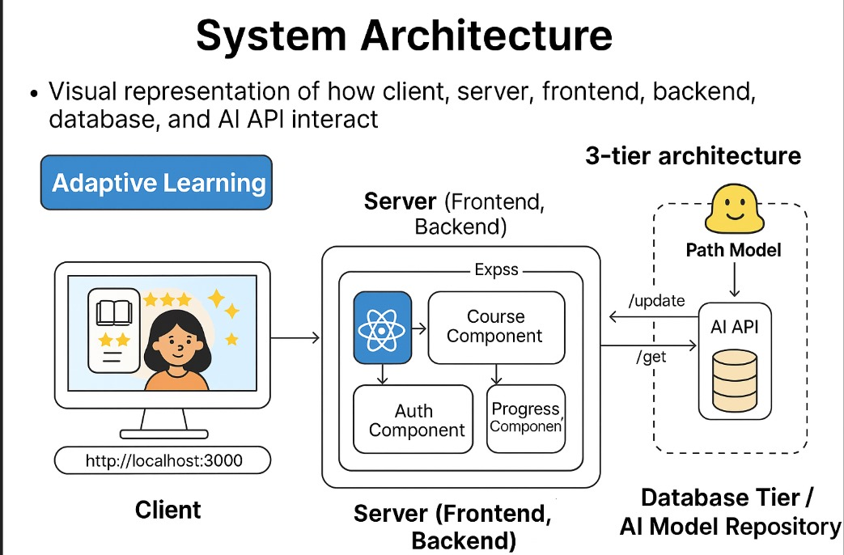
Tech stack overview:
Frontend: HTML ,CSS ,JS and React for a responsive UI and Face Mesh for real-time facial feature tracking and emotion detection
Backend: Node.js and Express for server-side logic and APIs
Database: MongoDB for storing user data and learning progress
Machine Learning: Python, TensorFlow, and Hugging Face Transformers for emotion recognition
Deployment: Cloud platform (e.g., AWS) for scalability and accessibility

Slide 7
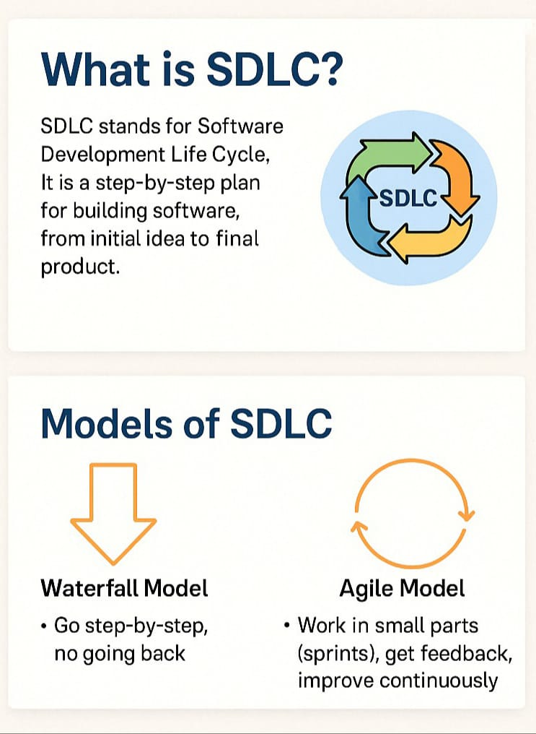
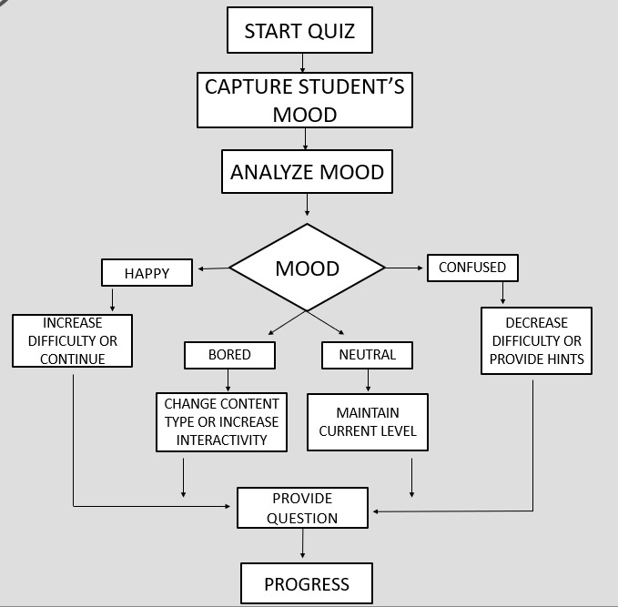
Process flow and SDLC:

Slide 8
Cloud deployment:
Cloud-Based Hosting: The app will be hosted on the cloud for better performance and accessibility.
Services Used: Platforms like AWS or Firebase will handle data storage, app hosting, and traffic management.
Scalability: Cloud deployment allows the app to scale easily based on user demand.
Availability & Security: Ensures the app is always available and secure for users.

Slide 9
THANK YOU

